Slide 1
Slide 1 – Title Slide
Predicting and Analyzing Urban Air Quality Using Multi-Source Data Integration Content: Course: MSDS692 – Data Science Practicum presented by:

Slide 2
Slide 2 – Introduction and Problem Context
Understanding the Challenge of Urban Air Pollution
The effects on the global population are serious as a majority (more than 90 percent) of the world population breathes unhealthy air quality.
Air pollution is one of the greatest environmental health threats, which lead to millions of premature deaths every year(Hunter, 2020) .
Forecasting Gap: Current AQI models are not very effective in changing the real-time environment..
Complex Drivers: There are various interrelated factors that determine pollution e.g. weather, traffic density, and industrial emissions.
Project Purpose: Predictive models utilizing pollutant, weather and traffic data to be used.

Slide 3
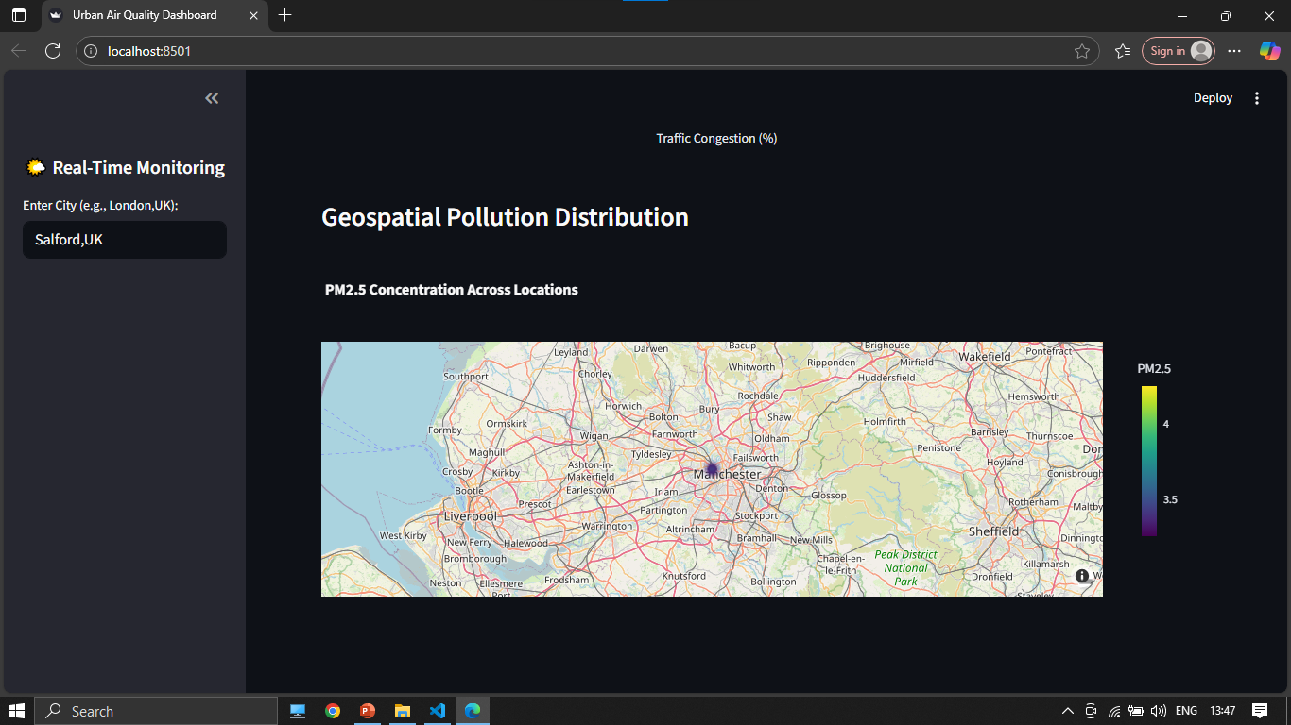
Slide 3:A Screenshot of Pollution Hotspot Map Showing AQI Distribution

Slide 4
Slide 4– Project Objectives
Objective | Explanation
Data Integration | Combine pollutant, traffic, and weather data to enhance prediction accuracy.
Pattern Analysis | Explore seasonal, temporal, and spatial trends using Exploratory Data Analysis (EDA).
Model Development | Apply ML models (Random Forest, XGBoost, LSTM) to forecast AQI.
Dashboard Design | Create an interactive Streamlit dashboard to visualize results in real-time.

Slide 5
Slide 5 – Data Sources and Description
Integrating Diverse Data Streams
Pollutant Data (Kaggle): Data on past AQI and pollutant levels (PM2.5, CO, NO 2, SO 2, O 3).
Weather (OpenWeatherMap API): This gives us the real-time temperature, humidity and wind speed(“WEATHER FORECASTING USING API: A COMPARATIVE STUDY,” 2023).
Traffic Data (Google Maps API): Records the congestion, speed average, and vehicle concentration.
Health Data (Optional): Respiratory illness statistics include context of health impact.

Slide 6
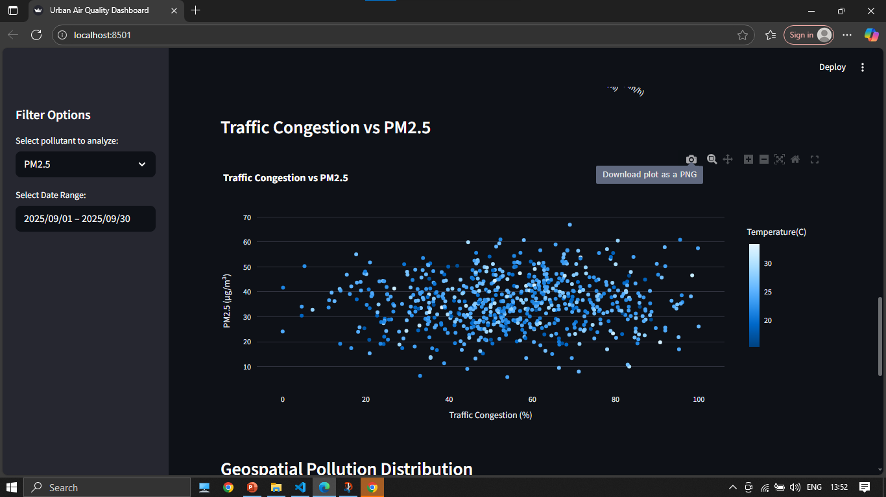
Slide 6:A Screenshot of Traffic Density Correlation with PM2.5 Concentration

Slide 7
Slide 7– Data Preparation and Cleaning
Ensuring Data Quality and Consistency Missing Values: Filled with median and interpolation to ensure completeness without any distortion of data trends.
Normalization Scaled features to similar ranges to enhance model balance and convergence.
Categorical Encoding: Mapped the weather descriptions to numbers to allow model interpretation.
Outlier Elimination: Techniques used are Applied Z-score and IQR in order to eliminate extreme or unrealistic readings, which lead to accurate predictions.

Slide 8
Slide 8 – Exploratory Data Analysis (EDA)
Discovering Key Patterns and Insights
Seasonal Trends: There have been significant increases in AQI in winter months, which can probably be explained by the fact that air dispersion and temperature inversion were lower in the winter period.
Weather Correlations: Humidity was observed to enhance concentration of pollution, and the speed of the wind was observed to be able to disperse the pollutants.
Traffic effect: AQI was the highest at peak times of rush and on high traffic congestion areas, which validates the contribution of motor emissions.
Geospatial Mapping: Heatmap showed that there were specific areas of pollution in the major urban and industrial city districts.

Slide 9
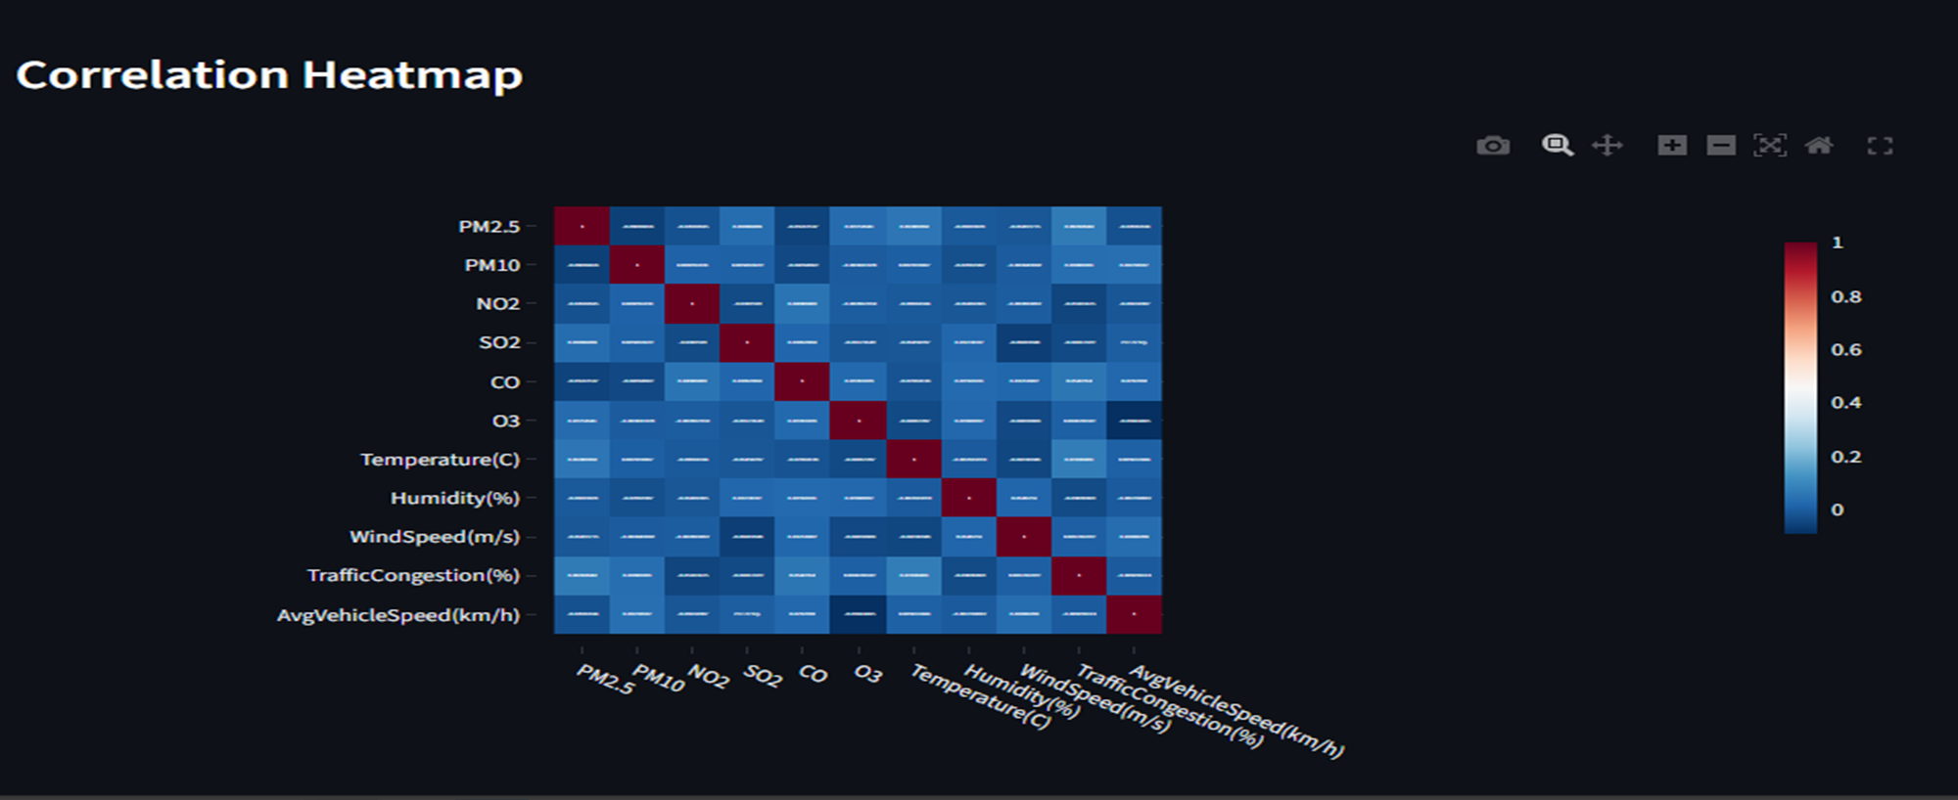
Slide 9:A Screenshot of Correlation Heatmap Showing Relationships Among Air Quality Indicators

Slide 10
Slide 10 – Feature Engineering
Enhancing Model Predictive Power
Lag Variables: Captured past pollution patterns to improve temporal prediction accuracy.
Interaction Terms: Combined weather and traffic data to reveal joint effects on AQI.
Seasonal Indicators: Incorporated time-based factors (hour, day, season) to model periodic trends.
SMOTE Application: Balanced AQI classes to prevent model bias and enhance fairness(Kabir et al., 2024).

Slide 11
Slide 11 – Model Development and Evaluation
Building and Testing Predictive Models
Baseline Models: The baseline model was the Random Forest which was used to give the initial performance of the model(Elissaios Sarmas et al., 2024).
XGBoost showed better predictive power and generalization on different datasets of data.
Deep Learning: LSTM was capable of modeling sequence changes in air quality and time relationships.
Metrics of validation: RMSE, MAE, and F1-score provided a complete analysis of performance and reliability.

Slide 12
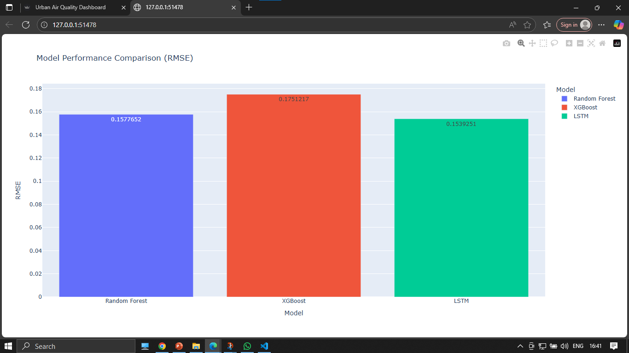
Slide 12 :A Screenshot of Model Performance Comparison for Air Quality Prediction

Slide 13
Slide 13 – Interactive Dashboard
From Data to Decision: Real-Time Visualization
Features:
Built With: It was built with Streamlit and Plotly so that it has a more user-friendly and attractive interface(Manouchehr Khorasani et al., 2022).
Dataset Mode: Displays past air quality trends and analytical information.Real-Time Mode: Retrieves and displays real-time weather and air quality information of the OpenWeatherMap AP(Ullah et al., 2020)I.
Forecasting: Predicts the trend of AQI within 48 hrs based on the trained random forest model.
User Controls: Enables sorting by date range, type of pollutant, temperature, humidity or amount of traffic to analyze it uniquely.

Slide 14
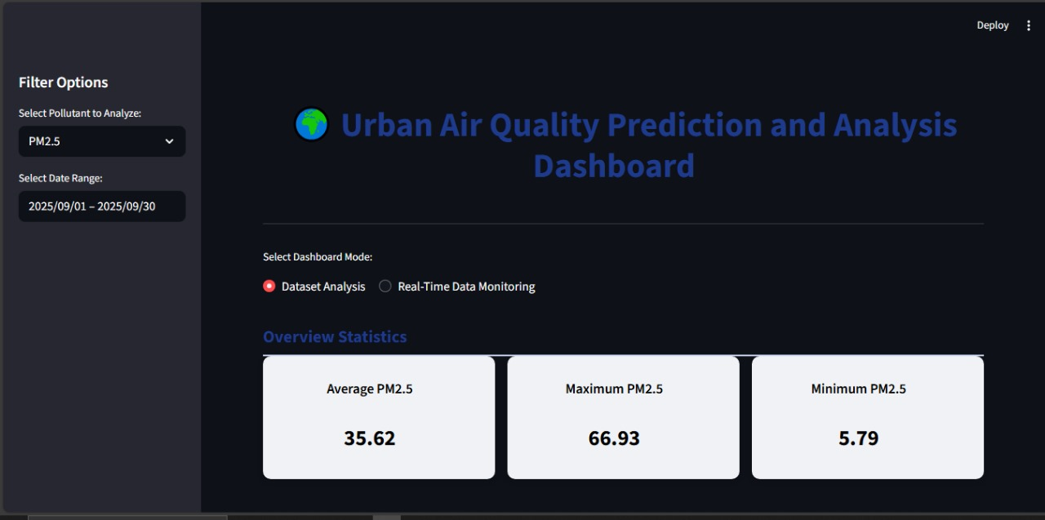
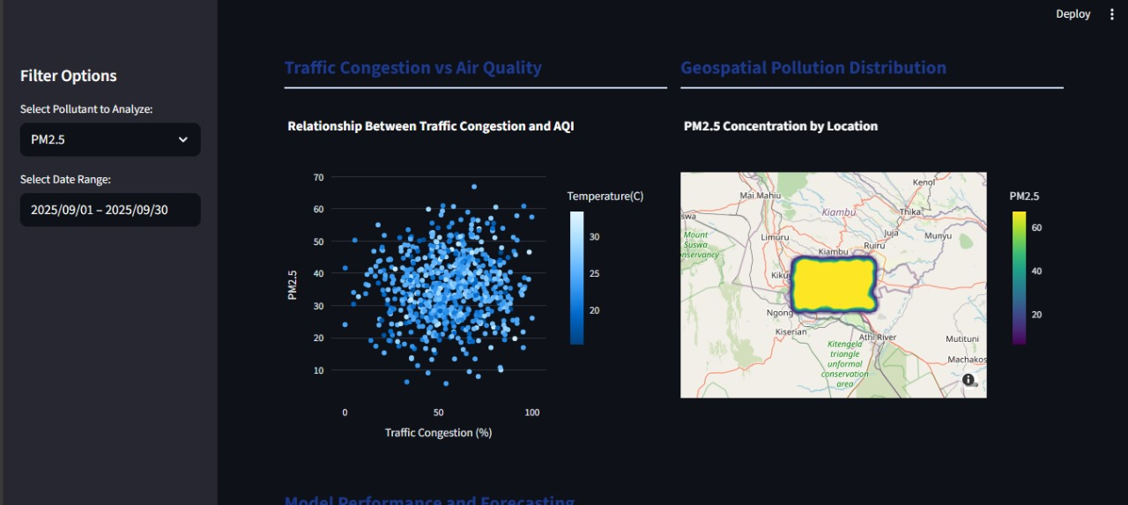
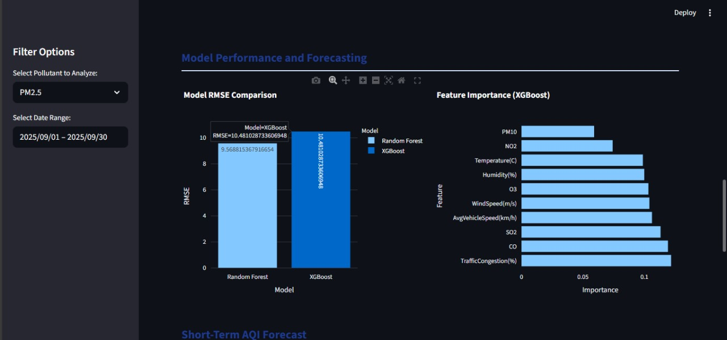
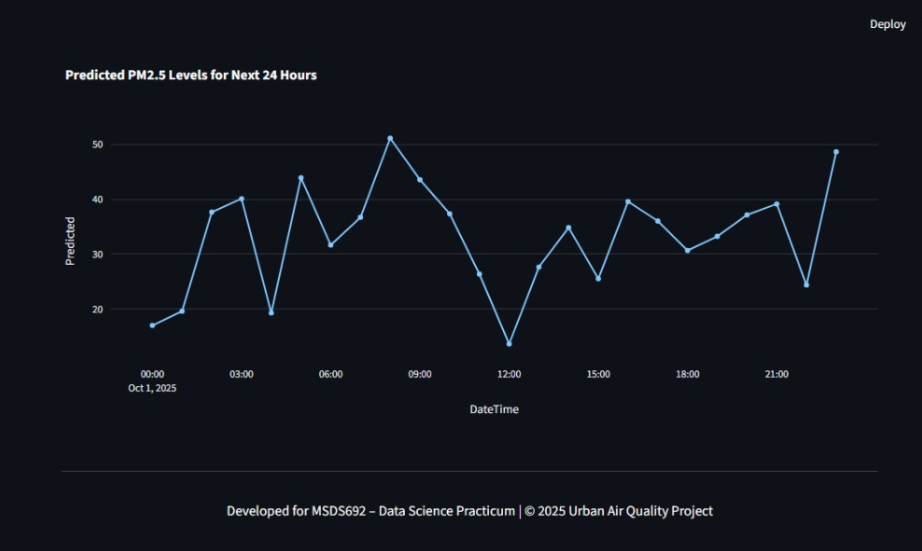
Slide 14 : Dashboard preview

Slide 15
Slide 15– Challenges and Solutions
Challenge | Solution
Computational Demand | Used GPU-based training and model caching.
Overfitting | Applied dropout, early stopping, and cross-validation.
API Delays | Cached API results to minimize load times.
Imbalanced Data | Used SMOTE and stratified k-fold validation.

Slide 16
Slide 16– Key Results and Insights
What the Data Revealed
Model Accuracy: XGBoost achieved the highest performance with the lowest RMSE and strongest F1-score, indicating reliable prediction accuracy(Uddin et al., 2024).
Feature Importance: Traffic congestion and humidity emerged as the most influential predictors of air quality variations.
Time-Series Prediction: The LSTM model effectively captured recurring weekly and seasonal pollution patterns.
Actionable Insights: Forecast outputs can guide urban planners in implementing traffic controls and issuing early pollution alerts.

Slide 17
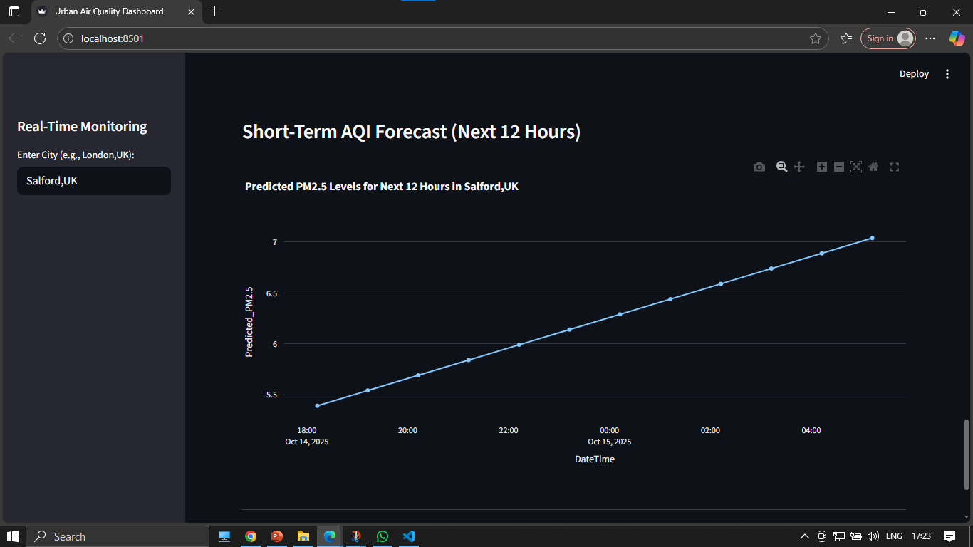
Slide 17:A Screenshot of Forecasted Air Quality Trends Using Random Forest Model

Slide 18
Slide 18 – Impact and Significance
Bridging Science and Policy for Urban Well-being
Policy Impact: Evidence-based policymaking to inform regulatory air quality management(Kim, 2024).
Public Awareness: Provides real-time notices and dashboards that would alert citizens on the degree of pollution and the risks to their health.
Environmental Sustainability: Endorses information-based traffic and emission management methods in clean urban centers.
Applications: The integration of machine learning, data visualization, and environmental analytics in applied research and urban innovation.

Slide 19
Slide 19 – Future Work
Extending the Project Beyond the Classroom
Integrate satellite imagery: Enhance spatial resolution and accuracy by incorporating satellite-based pollution observations(Stratoulias et al., 2024).
Incorporate deep neural networks: Use advanced architectures for improved long-term AQI trend prediction.
Deploy as public web app: Launch a user-friendly platform with secure access and real-time analytics.
Collaborate with agencies: Partner with environmental bodies to apply findings in policy and planning.

Slide 20
Slide 20 – Conclusion
Summary and Key Takeaway
Multi-source data integration: An integration of weather, traffic and pollution data to make more precise predictions of AQI.
Machine learning and visualization: Predictive models and dashboards are used to make evidence-based decisions at the city level.
Interactive dashboard: This will have scalable, transparent, and real-time air quality monitoring to manage the city.
Sustainability impact: Demonstrates the use of data science to achieve cleaner, smarter, and more sustainable cities.

Slide 21
Slide 21– References
Elissaios Sarmas, Aikaterini Forouli, Marinakis, V., & Doukas, H. (2024). Baseline energy modeling for improved measurement and verification through the use of ensemble artificial intelligence models. Information Sciences, 654, 119879–119879. https://doi.org/10.1016/j.ins.2023.119879
Hunter, P. (2020). The health toll of air pollution. EMBO Reports, 21(8). https://doi.org/10.15252/embr.202051183

Slide 22
Kabir, M. A., Ahmed, M. U., Begum, S., Barua, S., & Islam, M. R. (2024). Balancing Fairness: Unveiling the Potential of SMOTE-Driven Oversampling in AI Model Enhancement. 2021, 21–29. https://doi.org/10.1145/3674029.3674034
Kim, E.-S. (2024). Can data science achieve the ideal of evidence-based decision-making in environmental regulation? Technology in Society, 78, 102615–102615. https://doi.org/10.1016/j.techsoc.2024.102615

Slide 23
Manouchehr Khorasani, Abdou, M., & Javier Hernández Fernández. (2022). Web Application Development with Streamlit. In Apress eBooks. https://doi.org/10.1007/978-1-4842-8111-6
Stratoulias, D., Nuthammachot, N., Dejchanchaiwong, R., Tekasakul, P., & Carmichael, G. R. (2024). Recent Developments in Satellite Remote Sensing for Air Pollution Surveillance in Support of Sustainable Development Goals. Remote Sensing, 16(16), 2932. https://doi.org/10.3390/rs16162932

Slide 24
Uddin, I., Awan, H. H., Khalid, M., Khan, S., Akbar, S., Sarker, M. R., Maher, & Alghamdi, T. A. H. (2024). A hybrid residue based sequential encoding mechanism with XGBoost improved ensemble model for identifying 5-hydroxymethylcytosine modifications. Scientific Reports, 14(1). https://doi.org/10.1038/s41598-024-71568-z
Ullah, N., Khan, F., Khan, A. A., Khan, S., Tareen, A. W., Saeed, M., & Khan, A. (2020). Optimal Real-time Static and Dynamic Air Quality Monitoring System. Indian Journal of Science and Technology, 13(1), 1–12. https://doi.org/10.17485/ijst/2020/v13i01/148375

Slide 25
WEATHER FORECASTING USING API: A COMPARATIVE STUDY. (2023). International Research Journal of Modernization in Engineering Technology and Science. https://doi.org/10.56726/irjmets39530

